Slide 1
Operating Systems
Dr. Deepak Dembla

Slide 2
Process Communication and Synchronization

Slide 3
Objectives
Concurrent processes and their problems
Defining Critical section as a protocol for synchronization
Algorithmic approach to critical section implementation
Semaphore as a synchronization tool and its implementation
High-level language constructs for synchronization:
Critical region,
Conditional critical region,
Monitors,
Protected Objects
Solution of classical synchronization problems:
Producer-consumer problem,
Reader-writer problem,
Dining-philosophers problem,
Cigarette smokers problem,
Sleeping barber problem
Hardware support for process synchronization

Slide 4
Concurrent processes
Concurrent access of some resources
Sometimes the processes are dependent on each other. A process cannot start unless the other has finished.
Communication problem between the interacting processes
Although the independent processes do not affect each other but they compete for the resources.

Slide 5
There are two processes P1 and P2 sharing common variable shared. The process P1 updates the shared as
A1. reg1 = shared
A2. reg1 = reg1+3
A3. shared=reg1 shared = shared +3 and P2 updates the shared as
B1. reg2 = shared
B2. reg2 = reg2-3
B3. shared=reg2 shared = shared - 3
Data access synchronization

Slide 6
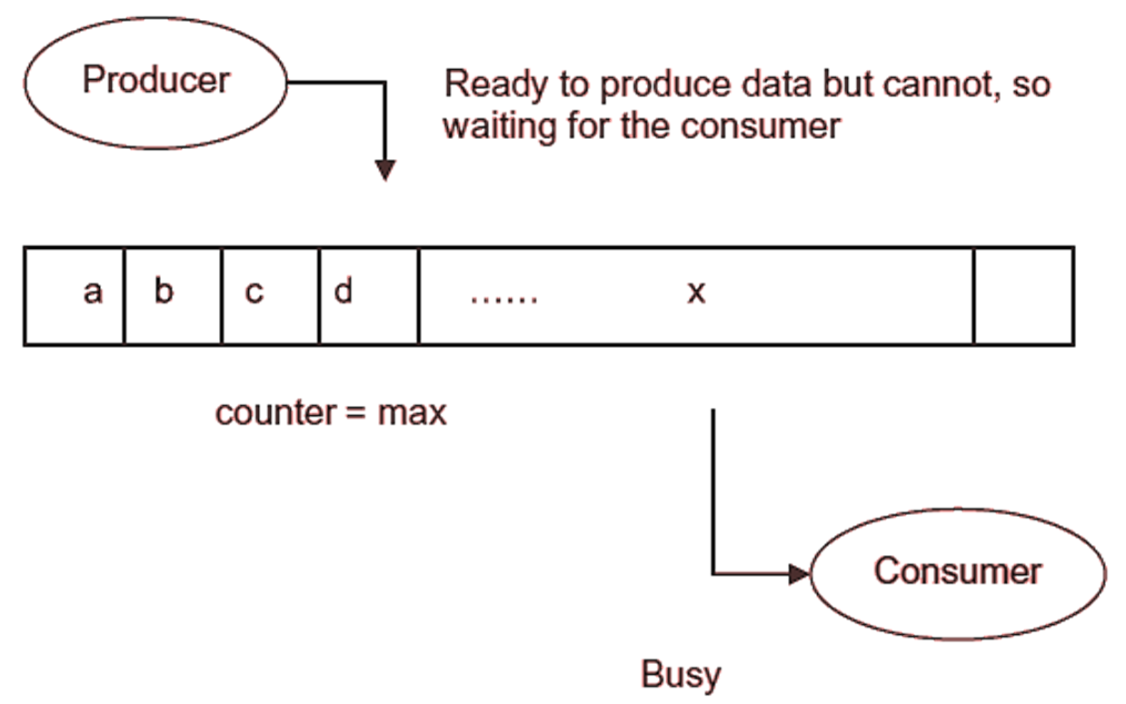
Producer-consumer problem: Buffer is full

Slide 7
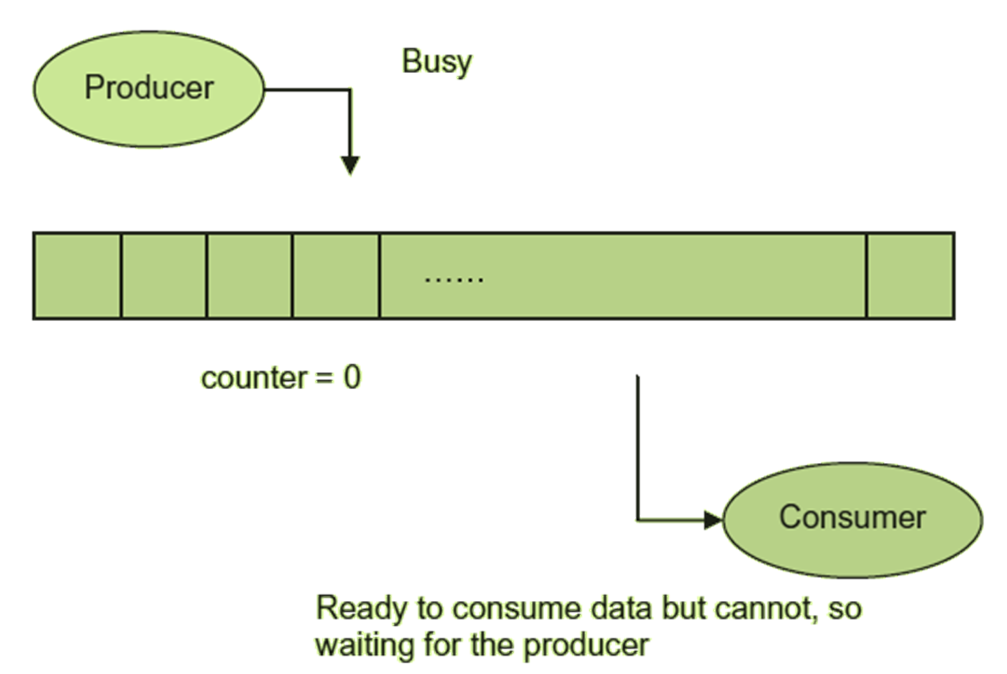
Producer-consumer problem: Buffer is empty

Slide 8
Process communication
Shared memory
Message passing
Synchronization between sender and process to send and receive the messages

Slide 9
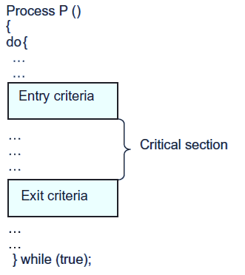
Protocol for critical section

Slide 10
Characteristics of protocol
Mutual Exclusion
Progress
Bounded wait
No deadlock

Slide 11
Algorithmic approach to critical section implementation
Two-process Solution
Dekker’s solution
Peterson’s solution

Slide 12
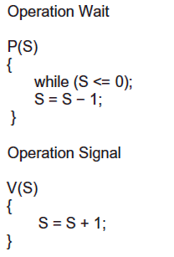
Semaphore

Slide 13
Semaphore types
Binary Semaphore
Counting Semaphore

Slide 14
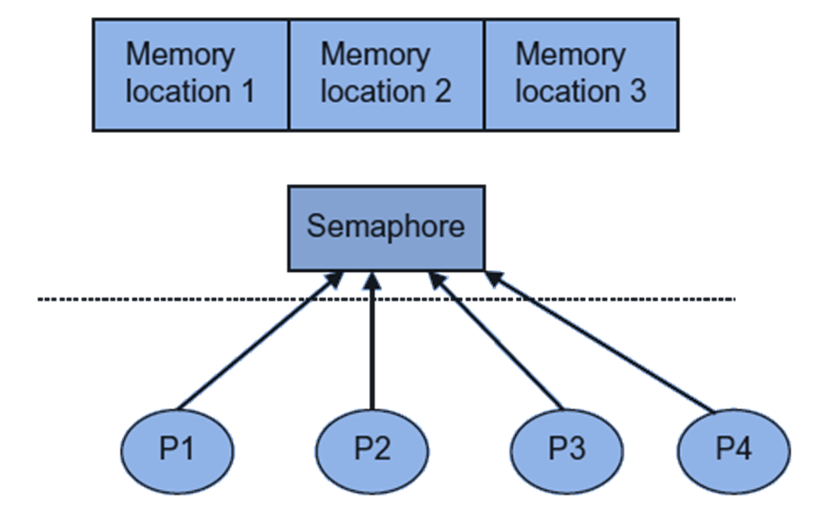
Counting semaphore

Slide 15
Mutex
In mutex type, the process which locks the critical section, i.e. value of mutex becomes 0, will only unlock it, i.e. the value of mutex becomes 1.
But in binary semaphore, there is no such restriction. The critical section locked by a process may be unlocked by any other process.

Slide 16
Empty semaphore initialized to n where n is the number of empty slots in the buffer.
Full semaphore initialized to 0
Buffer_access semaphore initialized to 1
Producer-consumer problem using Semaphore

Slide 17
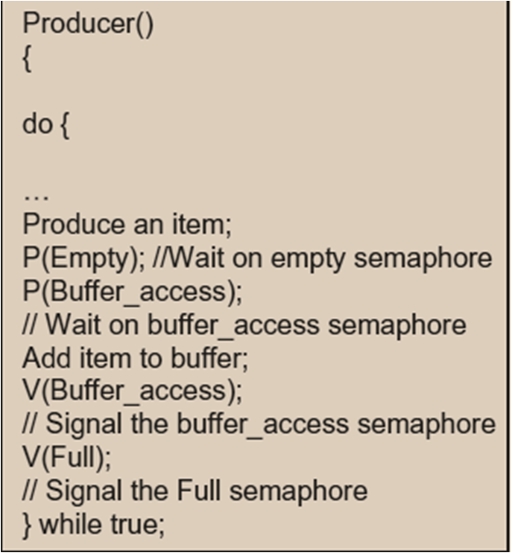
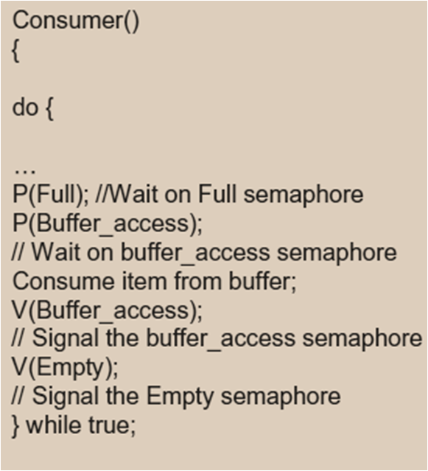
Algorithms for producer-consumer problem’s solution with Semaphore

Slide 18
Case 1: Readers have the priority
One reader process is inside the critical section and multiple writer processes arrive, then they must wait on the semaphore.
One writer process is inside the critical section and multiple reader processes arrive, then they must wait on the semaphore.
One reader process is inside the critical section and multiple reader processes arrive, then they will not wait on the semaphore.
One writer process is inside the critical section and multiple writer processes arrive, then they must wait on the semaphore.
Reader-Writer problem using Semaphore

Slide 19
ReadCount : integer variable as counter for reader processes; initialized as 0.
Sem_ReadCount: semaphore for ReadCount; initialized as 1
Sem_ReadWrite: semaphore for mutual exclusion between reader and writer processes; initialized as 1
Reader-Writer problem using Semaphore

Slide 20
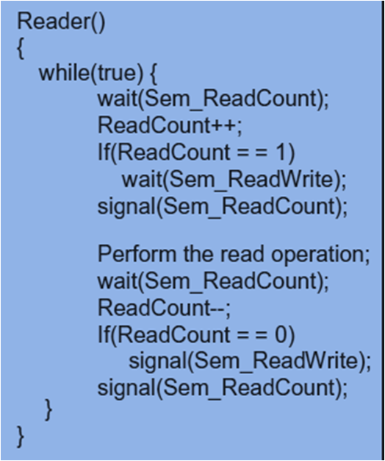
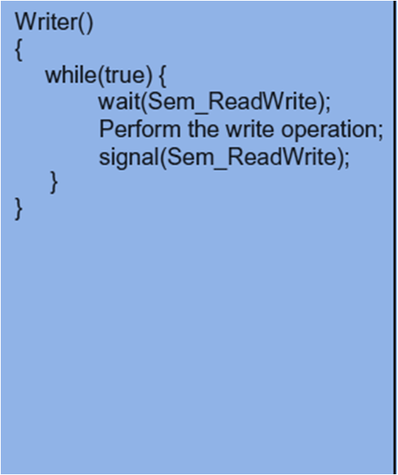
Algorithms for reader-writer problem’s solution with semaphore: Readers have priority

Slide 21
Case 2: Writers have the priority
Case 3: No Priority
Reader-Writer problem using Semaphore

Slide 22
Dining-Philosopher problem

Slide 23
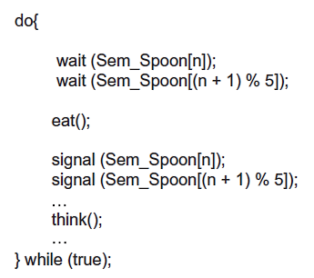
Dining-Philosopher problem’s solution: Attempt1

Slide 24
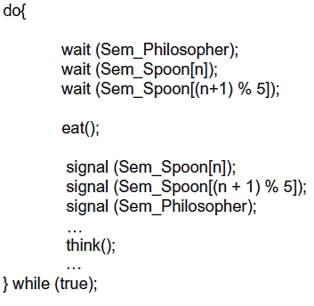
Dining-Philosopher problem’s solution: Attempt 2

Slide 25
Another solution to dining-philosopher problem without deadlock is an asymmetric solution which states that there should be at least one leftie and at least one rightie philosopher at the table. two philosophers are leftie and three are righties.
Dining-Philosopher problem’s solution

Slide 26
Dining-Philosopher problem’s solution: Attempt3
4
5
3
2
1

Slide 27
There can be one more solution with the restriction that odd numbered philosophers will pick up spoons on their left side first and then right one and even numbered will pick up spoons on their right side first and then left one.
Dining-Philosopher problem’s solution: Attempt3

Slide 28
Dining-Philosopher problem’s solution: Attempt4
4
5
5
4
3
1
3
2
2
1

Slide 29
Another solution for the dining-philosopher problem was given by Tanenbaum.
He defines the states of a philosopher. The possible states are: thinking, eating and waiting (hungry).
A semaphore is taken for every philosopher on which he waits to start eating. He can start eating only if neither of his neighbors is eating.
Dining-Philosopher problem: Tanenbaum’s solution

Slide 30
The state of a philosopher is checked and updated atomically; therefore another semaphore is used for this purpose.
Assume that states of all philosophers are thinking and all semaphores for 5 philosophers are initialized as 0. The data structures taken are int state[5];
Semaphore Sem_State =1;
Semaphore philosopher [5];
Dining-Philosopher problem: Tanenbaum’s solution

Slide 31
The left and right neighbour of a philosopher has been defined as
#define LEFT (n+5-1)%5 // number of left neighbour of nth philosopher
#define RIGHT (n+1)%5 // number of right neighbour of nth philosopher
Dining-Philosopher problem: Tanenbaum’s solution

Slide 32
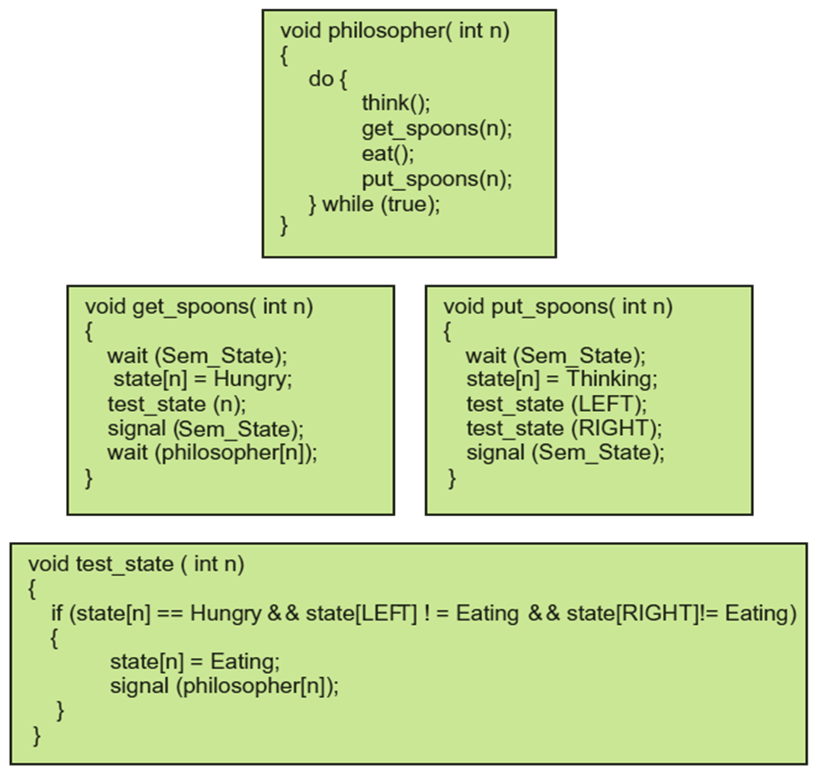
Dining-Philosopher problem: Tanenbaum’s solution

Slide 33
Three smokers S1, S2 and S3. All smokers prepare a cigarette themselves and smoke continuously. A cigarette is prepared and smoked with the help of three ingredients: tobacco, wrapping paper and matches. Each smoker has infinite supply of only one ingredient. So a smoker needs two more ingredients to prepare and smoke. For supplying the other two ingredients, there is a supplier having three vendors. Vendor V1 supplies tobacco and paper, V2 supplies paper and matches and V3 tobacco and matches.
Cigarette smokers problem

Slide 34
Every vendor supplies the two ingredients to the smokers at random. Depending on which ingredients are being supplied by supplier, the smoker with the complementary ingredient takes them and prepares the cigarette. He smokes it and signal to the supplier to supply the next lot of ingredients. For example, S1 has tobacco, S2 has paper and S3 has matches. If supplier offers paper and match, the smoker S1 will take these two ingredients, prepare the cigarette and smokes it.
Cigarette smokers problem

Slide 35
This problem is related to synchronization between a barber and his customers. In the barber’s shop there is one chair for him which he uses to sleep when there is no customer. If a customer enters, he wakes up the barber and gets his hair cut. If the barber is busy with one customer and more customers enter, they wait on the free chairs in the shop. If all the chairs are occupied and a customer enters, he leaves the shop. When the barber is finished with one customer he calls one of the customer and start cutting the hair. Others customers still wait. If there are no customers waiting, the barber goes to his chair and sleeps again until a customer comes to the shop. This process continues.
Sleeping barber problem

Slide 36
The problem is to synchronize the activities of barber and customers with predefined waiting chairs. It may be possible that the barber could end up waiting on a customer and a customer waiting on the barber, resulting in deadlock. Alternatively, customers may not decide to approach the barber in an orderly manner, leading to process starvation as some customers never get the chance for a hair cut even though they have been waiting. If two customers arrive at the same time and there is only one chair vacant, then how these two customers will synchronize?
Sleeping barber problem

Slide 37
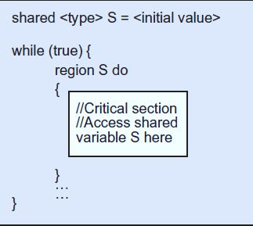
Critical Region

Slide 38
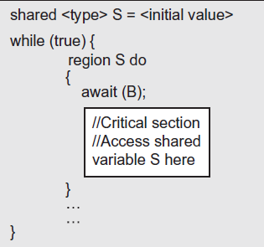
Conditional critical region

Slide 39
Shared Struct {
Item buffer[n]; // buffer which stores items of type Item in n sized buffer int buffer_size = n; int full = 0;
} Bounded_buffer;
Producer-Consumer problem’s solution with CCR

Slide 40
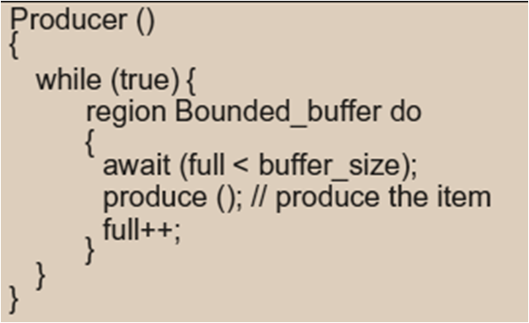
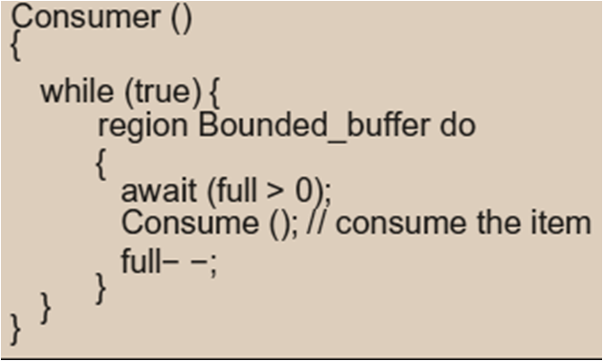
Producer-Consumer problem’s solution with CCR

